Slide 1
Biological Modeling of Neural Networks
Week 8 – parts 4-6 Noisy Output: Escape Rate and Soft Threshold
8.1 Variation of membrane potential
- white noise approximation
8.2 Autocorrelation of Poisson
8.3 Noisy integrate-and-fire
- superthreshold and subthreshold
8.4 Escape noise
- stochastic intensity
8.5 Renewal models
8.6 Comparison of noise models
Week 8 – Noisy output models:
Escape rate and soft threshold
Wulfram Gerstner
EPFL, Lausanne, Switzerland

Slide 2
Neuronal Dynamics – Review: Sources of Variability
- Intrinsic noise (ion channels)
Finite number of channels
Finite temperature
Na⁺
small contribution!
K⁺
Network noise (background activity)
Spike arrival from other neurons
Beyond control of experimentalist
Noise models?
big contribution!

Slide 3
Noise models
escape process,
stochastic intensity
stochastic spike arrival
(diffusive noise)
u(t)
t
escape rate
noisy integration
Now:
Escape noise!
Relation between the two models:
later

Slide 4
Neuronal Dynamics – 8.4 Escape noise
escape process
escape rate
u(t)
t
escape rate
Example: leaky integrate-and-fire model
u

Slide 5
Neuronal Dynamics – 8.4 stochastic intensity
escape process
Escape rate = stochastic intensity
of point process
u(t)
t
escape rate
examples
u

Slide 6
Neuronal Dynamics – 8.4 mean waiting time
escape rate
u(t)
t
u
1ms
I(t)
mean waiting time, after switch
t
Blackboard,
Math detour

Slide 7
Neuronal Dynamics – 8.4 escape noise/stochastic intensity
Escape rate = stochastic intensity
of point process
u(t)
t

Slide 8
Neuronal Dynamics – Quiz 8.4
Escape rate/stochastic intensity in neuron models
[ ] The escape rate of a neuron model has units one over time
[ ] The stochastic intensity of a point process has units one over time
[ ] For large voltages, the escape rate of a neuron model always saturates
at some finite value
[ ] After a step in the membrane potential, the mean waiting time until a spike is fired is proportional to the escape rate
[ ] After a step in the membrane potential, the mean waiting time until a spike is fired is equal to the inverse of the escape rate
[ ] The stochastic intensity of a leaky integrate-and-fire model with reset only depends on the external input current but not on the time of the last reset
[ ] The stochastic intensity of a leaky integrate-and-fire model with reset depends on the external input current AND on the time of the last reset

Slide 9
Biological Modeling of Neural Networks
Week 8 – part 5 : Renewal model
8.1 Variation of membrane potential
- white noise approximation
8.2 Autocorrelation of Poisson
8.3 Noisy integrate-and-fire
- superthreshold and subthreshold
8.4 Escape noise
- stochastic intensity
8.5 Renewal models
Week 8 – Variability and Noise:
Autocorrelation
Wulfram Gerstner
EPFL, Lausanne, Switzerland

Slide 10
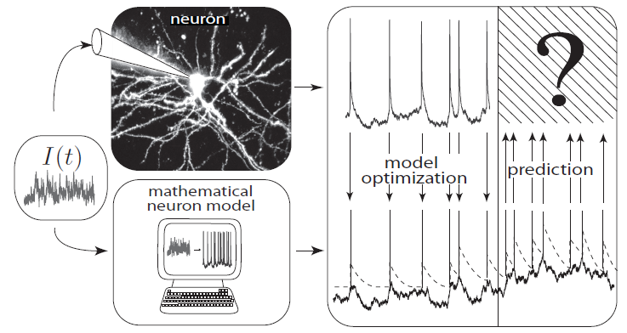
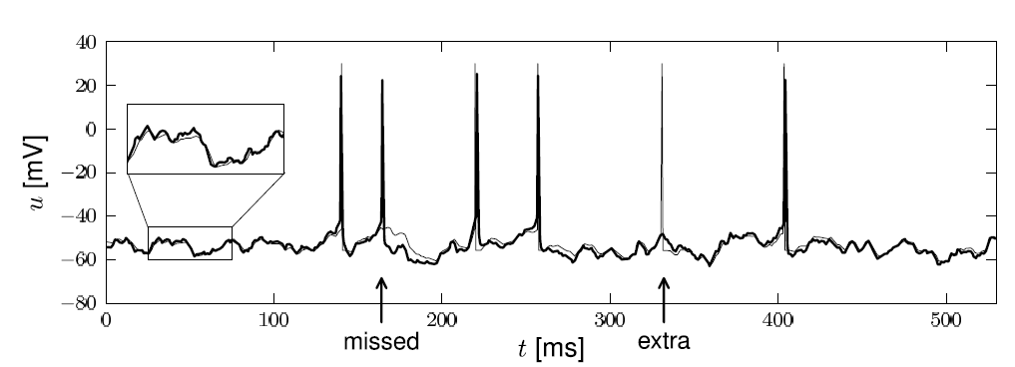
Neuronal Dynamics – 8.5. Interspike Intervals
t
deterministic part of input
noisy part of input/intrinsic noise
→ escape rate
Example:
nonlinear integrate-and-fire model
Example:
exponential stochastic intensity

Slide 11
Neuronal Dynamics – 8.5. Interspike Interval distribution
escape process
escape rate
u(t)
Survivor function
t
t
t

Slide 12
Neuronal Dynamics – 8.5. Interspike Intervals
escape process
Survivor function
Examples now
A
u(t)
t
escape rate
Interval distribution
escape
rate
Survivor function
u

Slide 13
Neuronal Dynamics – 8.5. Renewal theory
Example: I&F with reset, constant input
escape rate
Survivor function
1
Interval distribution

Slide 14
Neuronal Dynamics – 8.5. Time-dependent Renewal theory
Example: I&F with reset, time-dependent input,
escape rate
Survivor function
1
Interval distribution

Slide 15
Neuronal Dynamics – Homework assignement
neuron with relative refractoriness, constant input
escape rate
Survivor function
1
Interval distribution

Slide 16
Neuronal Dynamics – 8.5. Firing probability in discrete time
Probability to survive 1 time step
Probability to fire in 1 time step

Slide 17
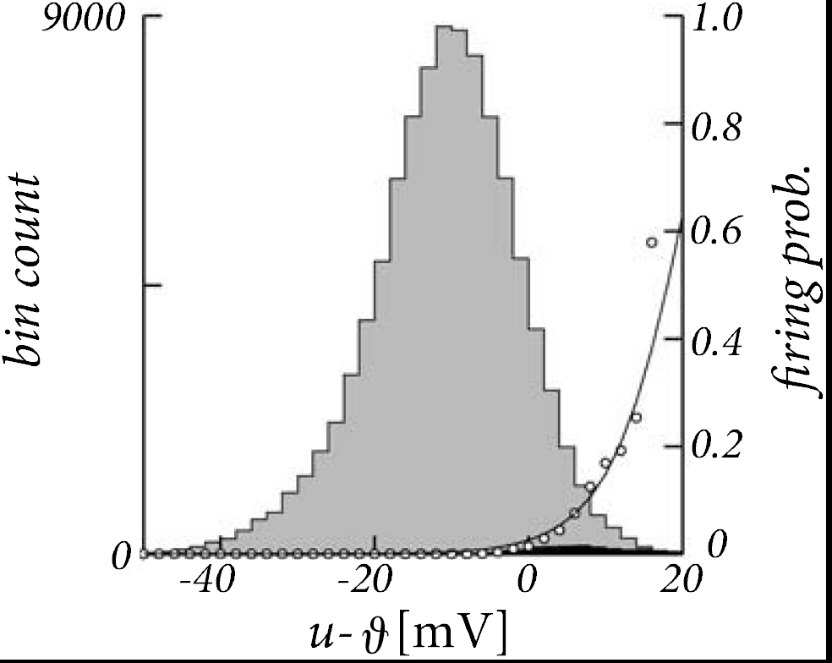
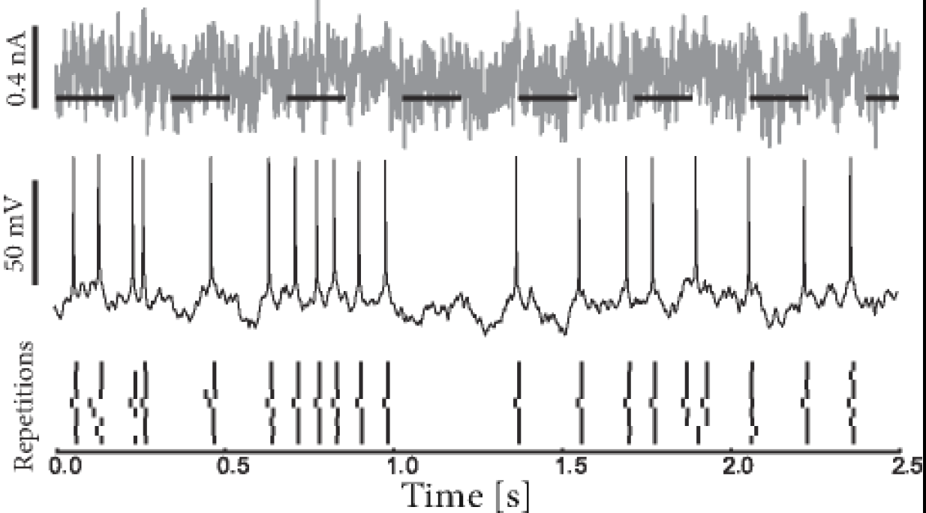
Neuronal Dynamics – 8.5. Escape noise - experiments
Jolivet et al. ,
J. Comput. Neurosc.
2006
escape rate

Slide 18
Neuronal Dynamics – 8.5. Renewal process, firing probability
Escape noise = stochastic intensity
Renewal theory
- hazard function
- survivor function
- interval distribution
time-dependent renewal theory
discrete-time firing probability
Link to experiments
→ basis for modern methods of
neuron model fitting

Slide 19
Biological Modeling of Neural Networks
Week 8 – part 6 : Comparison of noise models
8.1 Variation of membrane potential
- white noise approximation
8.2 Autocorrelation of Poisson
8.3 Noisy integrate-and-fire
- superthreshold and subthreshold
8.4 Escape noise
- stochastic intensity
8.5 Renewal models
8.6 Comparison of noise models
Week 8 – Noisy input models:
Barrage of spike arrivals
Wulfram Gerstner
EPFL, Lausanne, Switzerland

Slide 20
Neuronal Dynamics – 8.6. Comparison of Noise Models
escape process
(fast noise)
stochastic spike arrival
(diffusive noise)
u(t)
t
escape rate
noisy integration

Slide 21
Poisson spike arrival: Mean and autocorrelation of filtered signal
Filter
Assumption:
stochastic spiking
rate
mean
Autocorrelation of output
Autocorrelation of input

Slide 22
Diffusive noise (stochastic spike arrival)
Stochastic spike arrival:
excitation, total rate Re
inhibition, total rate Ri
Synaptic current pulses
EPSC
IPSC
Blackboard
u
Langevin equation,
Ornstein Uhlenbeck process

Slide 23
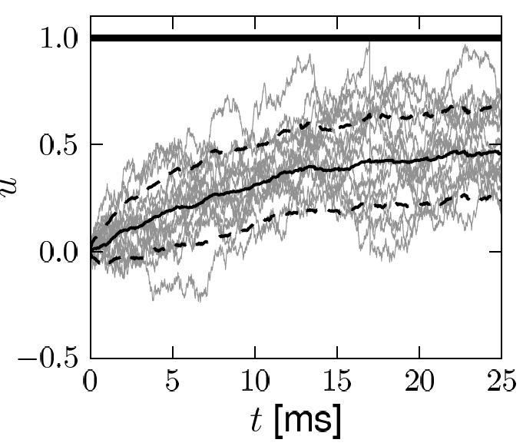
Diffusive noise (stochastic spike arrival)
Math argument:
- no threshold
- trajectory starts at
known value

Slide 24
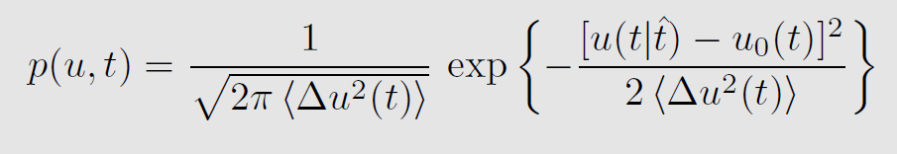
Diffusive noise (stochastic spike arrival)
Math argument

Slide 25
Neuronal Dynamics – 8.6. Diffusive noise/stoch. arrival
A) No threshold, stationary input
Membrane potential density: Gaussian
u
u
constant input rates
no threshold
p(u)
noisy integration

Slide 26
Neuronal Dynamics – 8.6 Diffusive noise/stoch. arrival
B) No threshold, oscillatory input
Membrane potential density:
Gaussian at time t
u
u
p(u(t))
noisy integration

Slide 27
Neuronal Dynamics – 6.4. Diffusive noise/stoch. arrival
C) With threshold, reset/ stationary input
Membrane potential density
u
u
p(u)

Slide 28
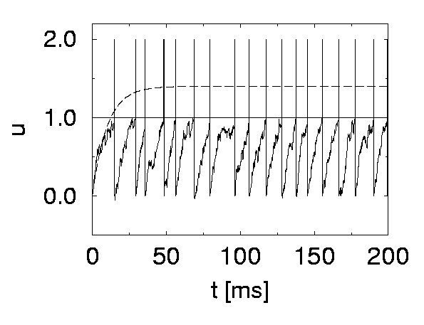
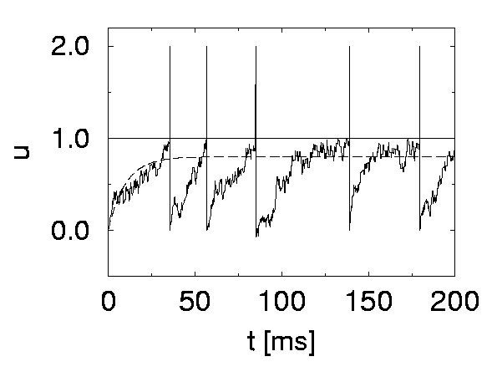
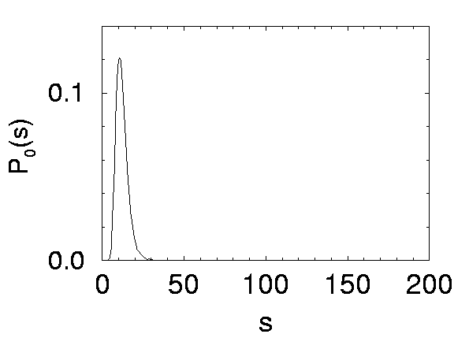
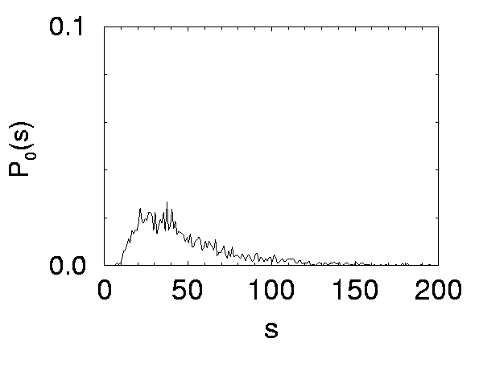
Neuronal Dynamics – 8.6. Diffusive noise/stoch. arrival
Superthreshold vs. Subthreshold regime
u
p(u)
p(u)
Nearly Gaussian
subthreshold distr.
Image:
Gerstner et al. (2013)
Cambridge Univ. Press;
See: Konig et al. (1996)

Slide 29
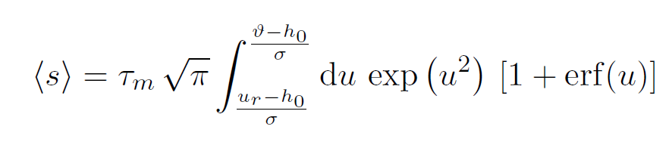
Neuronal Dynamics – 8.6. Comparison of Noise Models
escape process
(fast noise)
stochastic spike arrival
(diffusive noise)
A
C
u(t)
t
Stationary input:
Mean ISI
Mean firing rate
escape rate
noisy integration
Interval distribution
noise
Siegert 1951
white
(fast noise)
synapse
(slow noise)
: first passage
time problem
escape
rate
(Brunel et al., 2001)
Survivor function

Slide 30
Neuronal Dynamics – 8.6 Comparison of Noise Models
Diffusive noise
- distribution of potential
- mean interspike interval
FOR CONSTANT INPUT
- time dependent-case difficult
Escape noise
- time-dependent interval
distribution

Slide 31
Noise models: from diffusive noise to escape rates
noisy integration
stochastic spike arrival
(diffusive noise)
escape rate

Slide 32
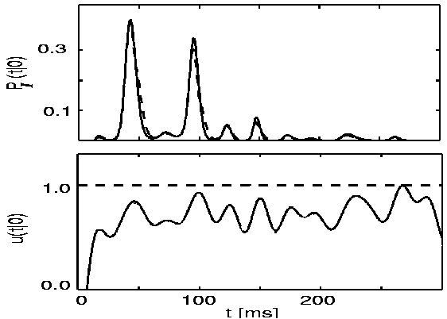
Comparison: diffusive noise vs. escape rates
Plesser and Gerstner (2000)
Probability of first spike
diffusive
escape
subthreshold
potential
escape rate

Slide 33
Neuronal Dynamics – 8.6 Comparison of Noise Models
Diffusive noise
- represents stochastic spike arrival
- easy to simulate
- hard to calculate
Escape noise
- represents internal noise
- easy to simulate
- easy to calculate
- approximates diffusive noise
- basis of modern model fitting methods

Slide 34
Neuronal Dynamics – Quiz 8.4.
A. Consider a leaky integrate-and-fire model with diffusive noise:
[ ] The membrane potential distribution is always Gaussian.
[ ] The membrane potential distribution is Gaussian for any time-dependent input.
[ ] The membrane potential distribution is approximately Gaussian for any time-dependent input,
as long as the mean trajectory stays ‘far’ away from the firing threshold.
[ ] The membrane potential distribution is Gaussian for stationary input in the absence of a threshold.
[ ] The membrane potential distribution is always Gaussian for constant input and fixed noise level.
B. Consider a leaky integrate-and-fire model with diffusive noise for time-dependent input. The above figure
(taken from an earlier slide) shows that
[ ] The interspike interval distribution is maximal where the determinstic reference trajectory is closest to the threshold.
[ ] The interspike interval vanishes for very long intervals if the determinstic reference trajectory
has stayed close to the threshold before - even if for long intervals it is very close to the threshold
[ ] If there are several peaks in the interspike interval distribution, peak n is always of smaller amplitude than peak n-1.
[ ] I would have ticked the same boxes (in the list of three options above)
for a leaky integrate-and-fire model with escape noise.

